Slide 1
HTTP with Sessions and Cookies
Web Development Day 1

Slide 2

Class Objectives
By the end of today’s class, we’ll be able to:
Understand HTTP requests and responses.
Use the curl command-line tool to make GET and POST requests and examine the responses.
Manage cookies using the Chrome extension Cookie-Editor.
Use Chrome's Developer Tools to audit HTTP request and response headers.
‹#›

Slide 3
The Web
from a Security Perspective
‹#›

Slide 4
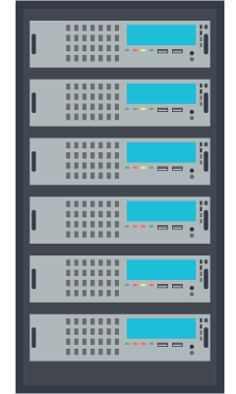


Intro to Offensive Security
This week will prepare us for the next four units, focused on Offensive Security.
In this unit, we’ll learn the foundations of modern web application architecture.
Then, we will learn popular exploits in Web Vulnerabilities.
After that, we will dive into ethical hacking and penetration testing.
‹#›
Notes:
shutterstock_717616198

Slide 5

The Web: A Security Perspective
In previous units, we learned about system administration and networking concepts.
This week, we will build on those concepts as we explore how web-based communication works in the client-server model.
We'll examine how we communicate over the web (networking) and how websites and web applications are created and deployed (system administration).
‹#›
‹#›
Notes:
shutterstock_1231549519

Slide 6

Web Development Overview
Throughout this week, we will look at how web applications work from the perspective of the user and the web developer/architect.
This week will cover the following:
What happens behind the scenes when we visit a webpage.
How websites “remember” us through cookies and sessions.
The architecture of web applications.
Deploying and managing data in a web application.
user
developer
‹#›
‹#›
Notes:
shutterstock_1482728201

Slide 7

Today’s topics will focus on what happens when we do everyday online activities, such as visit a website or log into an e-commerce site.
How our browsers send and receive data from a web server.
Using our browser to dive deeper into the data sent back and forth.
Using the command line to craft, manipulate, and examine data over the web.
How web applications “remember” who we are.
‹#›
Notes:
Image source: shutterstock_1550500559

Slide 8


The Web: A Security Perspective
It is increasingly important for security
professionals to understand the web.
Organizations are incorporating more web-based applications and services, such as Salesforce, into their operations.
Companies are moving their on-premises infrastructure and services to the cloud, e.g. using cloud-based backup services for servers.
Most people access the web on a daily basis, whether for shopping or streaming videos.
‹#›
Notes:
Image source: shutterstock_1421446100

Slide 9

The Web: A Security Perspective
Some of the major security roles that focus on web technologies are:
Web application security engineers must deeply understand how their company’s web application works and how to secure it.
Penetration testers are ethical hackers who try to find and exploit vulnerabilities and gain privileged access to web applications.
Risk assessors must understand the risk profiles and tolerances within web applications so they can help companies follow best practices and policies.
‹#›
Notes:
Image source: shutterstock_1421446100

Slide 10

The Web: A Security Perspective
The threats embedded in the modern web are constantly growing.
The web represents most organizations' largest attack surfaces.
The number of users accessing the web at all times, through PCs, phones, or other devices, is constantly growing.
The collective amount of personal data stored on the web is growing significantly. Attackers can steal and sell it.
Source: WIRED
‹#›

Slide 11
Understanding the Web:
HTTP Requests and Responses
‹#›

Slide 12
Preliminary Information
Securing the web requires in-depth knowledge of topics we covered previously:
Client-server architecture
HyperText Transfer Protocol (HTTP)
HTTP requests
HTTP responses

Slide 13

Client-Server Architecture
The client-server model is an exchange of information, a cycle of requests and responses between clients and servers.
HTTP
protocol
Web client
Web server
Web server
Database
A user’s device communicates with a server to request resources from it.
The server queries the resources from internal servers it’s connected to.
The server sends a response back to the client.
‹#›
Notes:
Image source: shutterstock_498308449, shutterstock_704749705, shutterstock_503974285

Slide 14


HTTP Requests
Clients and servers use the HTTP protocol to communicate on the web.
HTTP is a Layer 7: Application Layer protocol used to transfer webpages, static assets, such as images and HTML/markup files, and raw data, such as MP4 video or MP3 audio.
When a client initiates communication, it generates an HTTP request. The server receives the request, finds the requested resource, and sends it back.
1
2
‹#›

Slide 15
HTTP Methods
There are various types of requests, known as HTTP methods, which indicate the specific actions between the client and server. For example:
A user requests data from a server:
I'd like to see my friend’s photos on Facebook.
A user gives data to a server:
Here are my credentials for my LinkedIn account.
A user updates data that already exists on a server:
Two new accounts are added to the employee directory database.
‹#›

Slide 16
HTTP Methods
There are various HTTP methods:
HTTP Method | Description
GET | Requests data from a server.
HEAD | Identical to GET, but the server does not send the response body.
POST | Sends data to a source, often changing or updating a server.
PUT | Replaces current data with the new value.
DELETE | Deletes a specified resource.
CONNECT | Establishes a tunnel to the server.
OPTIONS | Lists the communication options for target resource.
‹#›

Slide 17
HTTP Methods
We’ll focus on GET and POST requests.
HTTP Method | Description | Example
GET | Requests data from a server. | When you open a browser and go to amazon.com, the HTTP client (your browser) asks to GET the data that the URL (amazon.com) points to. That data is the webpage.
POST | Sends data to a source, often changing or updating a server. | Once your browser goes to amazon.com, you log into your Amazon account. The client sends a POST request that contains your credentials for logging in.
‹#›

Slide 18
Anatomy of a GET Request
GET /js/analytics.js HTTP/1.1
Host: www.target-server.com
Connection: keep-alive
Upgrade-Insecure-Request: 1
Accept: text/js, text/html, */*
Accept-Language: en-us
Accept-Encoding: gzip, deflate
User-Agent: Mozilla/4.0
Request Line
Headers
White space
Request Body (optional)
‹#›

Slide 19
Request Line
GET /js/analytics.js HTTP/1.1
Host: www.target-server.com
Connection: keep-alive
Upgrade-Insecure-Request: 1
Accept: text/js, text/html, */*
Accept-Language: en-us
Accept-Encoding: gzip, deflate
User-Agent: Mozilla/4.0
A request line contains the request method, the name of the requested resource, and the version of HTTP in use.
The request line can also contain query parameters, which the client can use to send data to the server.
‹#›

Slide 20
Headers
Headers contain additional details about the requested resource. They contain many actions with security implications, such as authentication and remembering user resources.
You don’t have to remember every type of header. We’ll cover some of the most important ones in class.
GET /js/analytics.js HTTP/1.1
Host: www.target-server.com
Connection: keep-alive
Upgrade-Insecure-Request: 1
Accept: text/js, text/html, */*
Accept-Language: en-us
Accept-Encoding: gzip, deflate
User-Agent: Mozilla/4.0
‹#›

Slide 21
Whitespace
GET /js/analytics.js HTTP/1.1
Host: www.target-server.com
Connection: keep-alive
Upgrade-Insecure-Request: 1
Accept: text/js, text/html, */*
Accept-Language: en-us
Accept-Encoding: gzip, deflate
User-Agent: Mozilla/4.0
Whitespace is a blank line indicating the end of the request.
‹#›

Slide 22
HTTP Request: Request Line
GET /js/analytics.js HTTP/1.1
Host: www.target-server.com
Connection: keep-alive
Upgrade-Insecure-Request: 1
Accept: text/js, text/html, */*
Accept-Language: en-us
Accept-Encoding: gzip, deflate
User-Agent: Mozilla/4.0
The request method is GET.
The requested resource is /js/analytics.js. This resource is the file path from the domain stated in the header.
The request browser uses HTTP version 1.1.
‹#›
‹#›

Slide 23
HTTP Request: Headers
GET /js/analytics.js HTTP/1.1
Host: www.target-server.com
Connection: keep-alive
Upgrade-Insecure-Request: 1
Accept: text/js, text/html, */*
Accept-Language: en-us
Accept-Encoding: gzip, deflate
User-Agent: Mozilla/4.0
Host contains the domain name of the target server.
Note that the protocol (HTTP) + host + file path in the request line is the URL we see in the browser:
http://www.target-server.com/js/analytics.js
‹#›

Slide 24
HTTP Request: Headers
GET /js/analytics.js HTTP/1.1
Host: www.target-server.com
Connection: keep-alive
Upgrade-Insecure-Request: 1
Accept: text/js, text/html, */*
Accept-Language: en-us
Accept-Encoding: gzip, deflate
User-Agent: Mozilla/4.0
Connection tells the server to keep open the TCP connection used for this HTTP transfer after sending the response.
This allows the client-server to reuse the connection for later requests.
The alternative is performing a TCP handshake, which is much slower.
‹#›

Slide 25
HTTP Request: Headers
Upgrade-Insecure-Requests tells the server to turn this HTTP connection into HTTPS, so the response and future communications will be encrypted.
Accept tells the server that the client expects a JavaScript or HTML document in response, but will accept data of any type (*/*).
User-Agent tells the server that this request comes from a Mozilla 4.0 browser.
GET /js/analytics.js HTTP/1.1
Host: www.target-server.com
Connection: keep-alive
Upgrade-Insecure-Request: 1
Accept: text/js, text/html, */*
Accept-Language: en-us
Accept-Encoding: gzip, deflate
User-Agent: Mozilla/4.0
‹#›

Slide 26

Headers
Other important headers include:
Authorization: Contains credentials to authenticate a user with a server.
Referer: Contains the address of the previous webpage that linked to the currently requested page. Allows servers to identify where people are visiting from, and can use that data for analytics, logging, or optimized caching. (If a link from a Google search led to the current page, the referrer is Google.)
Cookie: Contains stored HTTP cookies previously sent by the server with the Set-Cookie response header.
‹#›

Slide 27
Requests with Query Parameters
GET requests can also request data with query parameters.
Query parameters are useful for specifying the parts of a resource to receive or send data.
This GET request specifically requests articles with two parameters: the latest articles, created by author jane.
GET /articles?tag=latest&author=jane HTTP/1.1
Host: www.target-server.com
Connection: keep-alive
Upgrade-Insecure-Request: 1
Accept: text/js, text/html, */*
Accept-Language: en-us
Accept-Encoding: gzip, deflate
User-Agent: Mozilla/4.0
‹#›

Slide 28
Requests with Query Parameters
GET requests can also request data with query parameters.
Query parameters are useful for specifying the parts of a resource to receive or send data.
This GET request specifically requests articles with two parameters: the latest articles, created by author jane.
GET /articles?tag=latest&author=jane HTTP/1.1
Note the syntax for parameters:
[path]?[firstParam]=[value]&[secondParam]=[value]
‹#›

Slide 29
Anatomy of a POST Request
HTTP POST requests are similar to GET requests, but include a request body below the whitespace.
The request body may contain information such as login credentials or a file to be uploaded. In the current example, our request body contains login credentials.
POST /api/users HTTP/1.1
Host: www.target-server.com
User-Agent: Mozilla/4.0
Accept: */*
Content-Length: 23
Content-Type: application/x-www-form-urlencoded
username=Jane+Doe&password=p455
‹#›

Slide 30
Anatomy of an HTTP Response
HTTP/1.1 200 OK
Date: Nov 12 02:12:12 2018
Server: Apache/2.4.7 (Ubuntu)
X-powered-By: PHP/5.5.9-lubuntu4.21
Cache-Control: no-cache
Set-Cookie: SESSID=8toks; httponly
Content-Encoding: gzip
Content-Length: 698
function getStats(event) {
...
Status Line
Headers
Whitespace
Response Body
‹#›

Slide 31
Anatomy of an HTTP Response
HTTP/1.1 200 OK
Date: Nov 12 02:12:12 2018
Server: Apache/2.4.7 (Ubuntu)
X-powered-By: PHP/5.5.9-lubuntu4.21
Cache-Control: no-cache
Set-Cookie: SESSID=8toks; httponly
Content-Encoding: gzip
Content-Length: 698
function getStats(event) {
...
A status line contains the response status code and phrase that translates the result, such as OK or Error.
Headers contain additional information about the response, similar to response headers.
A whitespace separates the header with the following response body.
A response body contains the resource requested by the client.
‹#›

Slide 32
Anatomy of an HTTP Response
HTTP/1.1 200 OK
Date: Nov 12 02:12:12 2018
Server: Apache/2.4.7 (Ubuntu)
X-powered-By: PHP/5.5.9-lubuntu4.21
Cache-Control: no-cache
Set-Cookie: SESSID=8toks; httponly
Content-Encoding: gzip
Content-Length: 698
function getStats(event) {
...
The response uses unencrypted HTTP/1.1.
The status code is 200 OK, meaning the request was processed properly.
‹#›

Slide 33
HTTP Response: Status Line
HTTP/1.1 200 OK
Date: Nov 12 02:12:12 2018
Server: Apache/2.4.7 (Ubuntu)
X-powered-By: PHP/5.5.9-lubuntu4.21
Cache-Control: no-cache
Set-Cookie: SESSID=8toks; httponly
Content-Encoding: gzip
Content-Length: 698
function getStats(event) {
...
Date contains a timestamp of when the response was generated.
Server indicates the server is running PHP version 5.5.9 on Lubuntu with kernel version 4.21.
‹#›

Slide 34
HTTP Response: Status Line
HTTP/1.1 200 OK
Date: Nov 12 02:12:12 2018
Server: Apache/2.4.7 (Ubuntu)
X-powered-By: PHP/5.5.9-lubuntu4.21
Cache-Control: no-cache
Set-Cookie: SESSID=8toks; httponly
Content-Encoding: gzip
Content-Length: 698
function getStats(event) {
...
Set-Cookie tells the client to create a cookie called SESSID with the value 8toks, and that this cookie can only be set by the server with HTTP.
We'll discuss cookies and httponly in greater detail later.
‹#›

Slide 35
HTTP Response: Response Body
HTTP/1.1 200 OK
Date: Nov 12 02:12:12 2018
Server: Apache/2.4.7 (Ubuntu)
X-powered-By: PHP/5.5.9-lubuntu4.21
Cache-Control: no-cache
Set-Cookie: SESSID=8toks; httponly
Content-Encoding: gzip
Content-Length: 698
function getStats(event) {
...
Below the whitespace is the response body, which contains the source code of the resource requested in the GET request.
‹#›

Slide 36


Status Codes
General status codes include:
200 codes indicate success.
300 codes indicate multiple choices, meaning the server can respond to the request in more than one way.
400 codes indicate client errors, meaning the client sent a improperly formatted request.
You probably recognize the 404 error.
500 codes indicate server errors, meaning the server application failed somehow.
‹#›
Notes:
Image source: shutterstock_1009594870

Slide 37
Activity: HTTP Request and Response
In this activity you will investigate HTTP
logs to figure out the sequence of events that took place during an attack on your
company’s web server.
15 Minutes

Slide 38
‹#›

Slide 39
Examining HTTP and Cookies with DevTools
‹#›

Slide 40
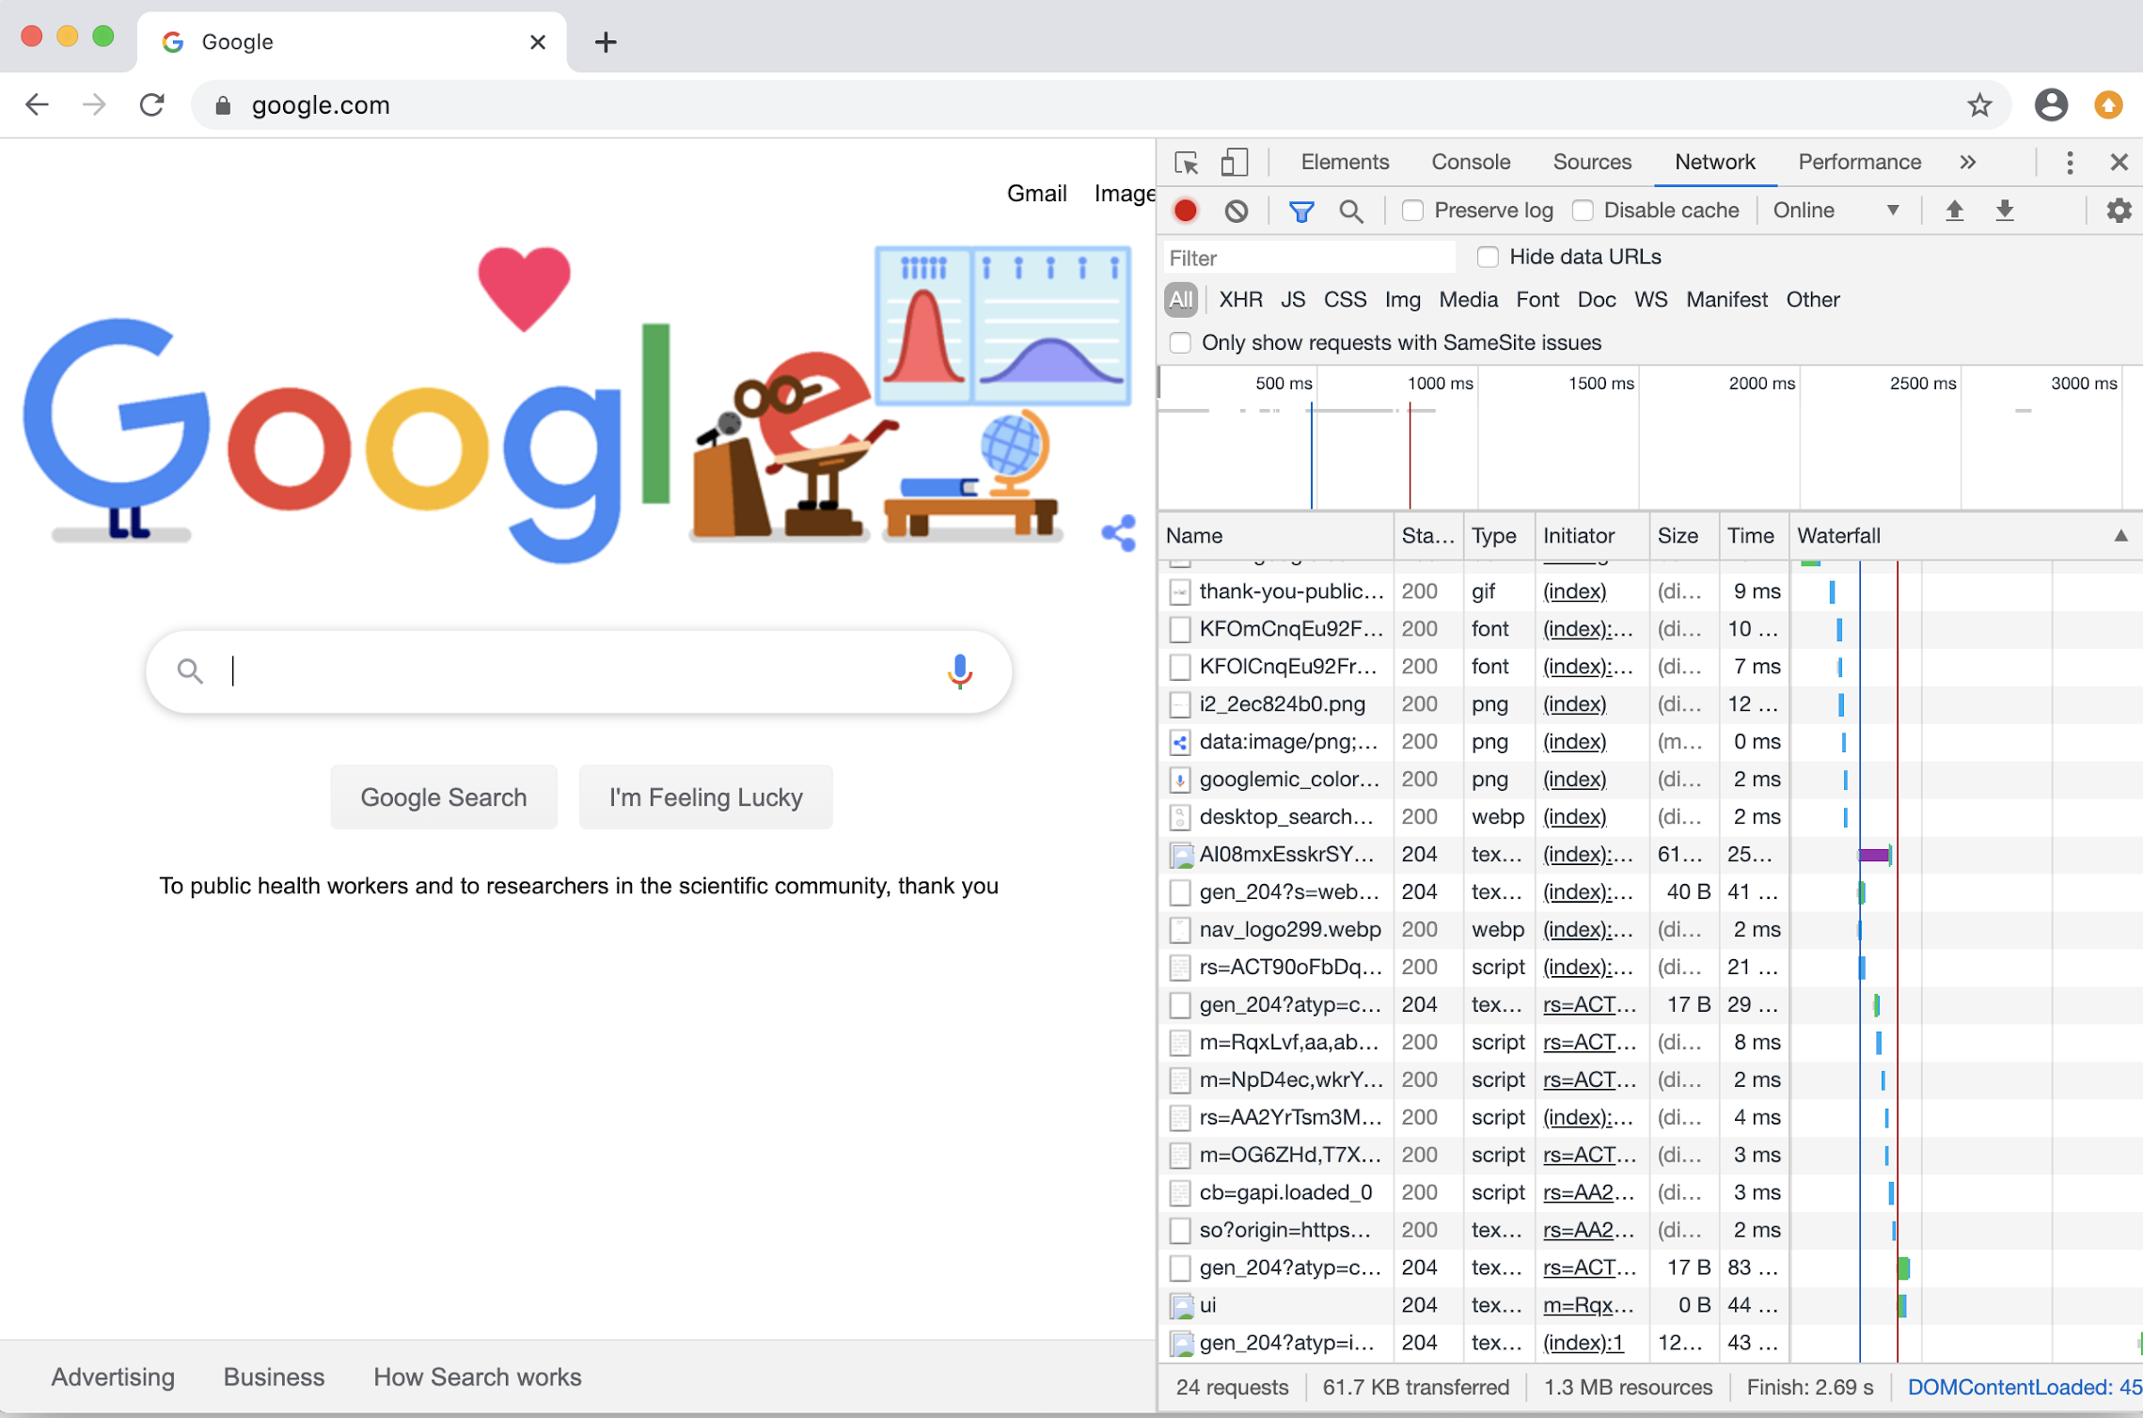
Chrome Developer Tools
Now we will deconstruct and examine a web application using the tools within a browser. These allow us to:
Understand the request and response flows between an HTTP client and server.
Examine the security implementations of a website through its response headers.
Identify where cookies are used in the HTTP request-response cycle.
‹#›

Slide 41
Chrome DevTools
‹#›

Slide 42
Activity: Inspecting with Developer Tools
In this activity, you will use your browser’s Developer Tools to examine the request and response set from www.crowdstrike.com.
10 Minutes
‹#›

Slide 43
‹#›

Slide 44
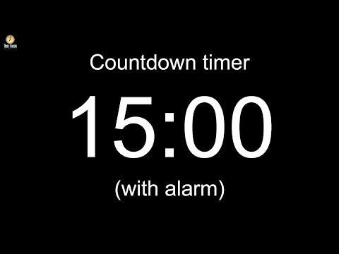
Notes:
Image source: AdobeStock_56885471
Break

Slide 45
curl
‹#›

Slide 46

Introducing curl
We can’t always examine HTTP requests and responses through a browser.
Sometimes, the tools you can use to send and receive HTTP requests are limited.
For example, when working through a container that has no user interface, you'll need a command-line tool to send and receive HTTP requests.
Cybersecurity professionals need to be able to quickly test HTTP requests in a way that can be automated, but also allows them to make adjustments.
The command-line tool curl allows security professional to do exactly this.
‹#›
Notes:
Image source: https://curl.haxx.se/

Slide 47
curl
curl is a command-line client that allows us to send data to and from servers. This allows security professionals to:
Test web server security configurations.
Ensure web servers don’t leak sensitive data through their HTTP responses.
Verify that servers only respond to certain types of requests.
Look for vulnerabilities on a web server.
‹#›

Slide 48
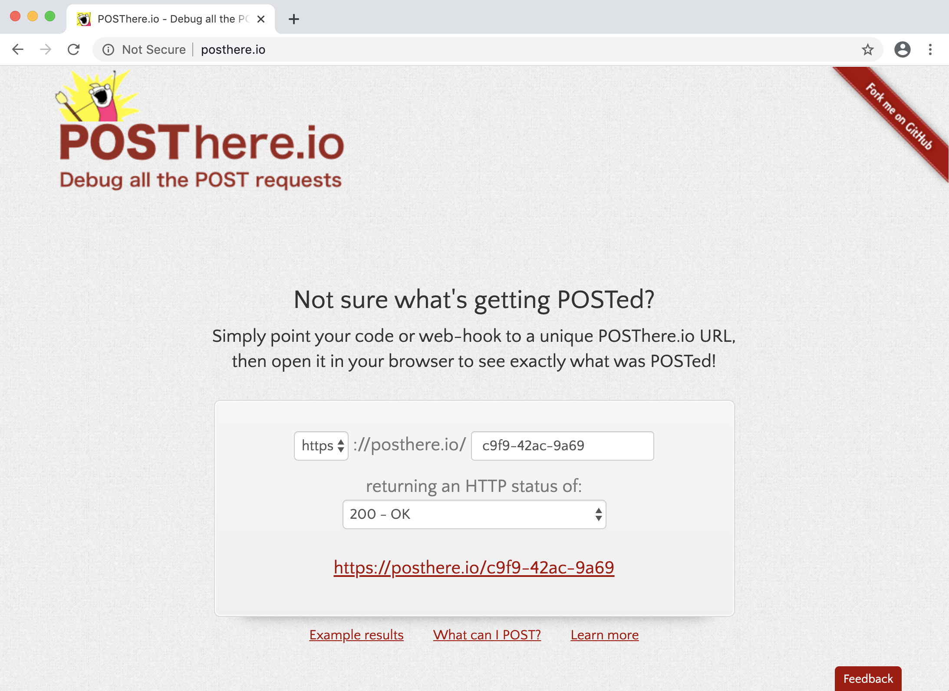
curl
We’ll demonstrate curl using the website POSThere.io.
‹#›

Slide 49
curling
‹#›

Slide 50
Activity: Using curl
In this activity, you will write various curl commands to interact with an HTTP web server and return responses.
15 Minutes
‹#›

Slide 51
‹#›

Slide 52
Sessions and Cookies
‹#›

Slide 53

Sessions and Cookies
HTTP resources are inherently stateless, meaning that when your browser requests a webpage, the webpage can’t distinguish you from others.
Websites need a way to deliver content that is specific to each user. To do so, they establish sessions with cookies.
Sessions are unique server-side sets of user data used to customize webpages for the specific user accessing them.
Cookies are small pieces of text data that, when sent by an HTTP server's response header, are saved by the user's HTTP client.
‹#›
Notes:
Image source: shutterstock_668165704

Slide 54
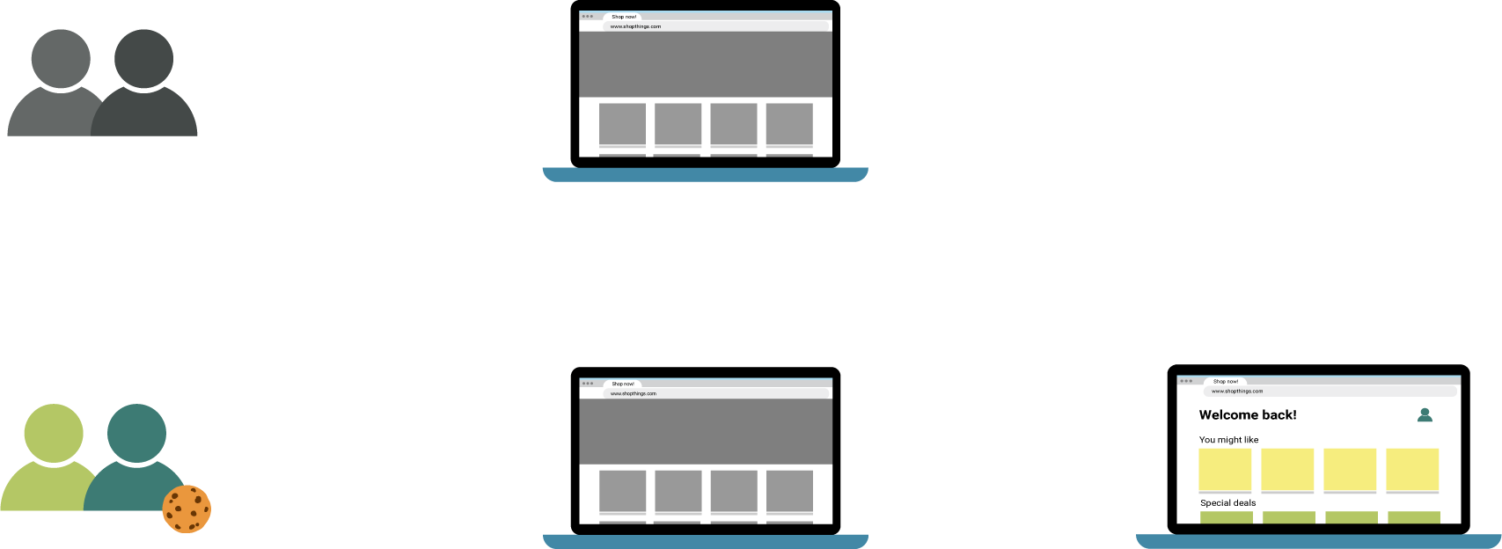
Sessions and Cookies
You visit a shopping website and register an account with your first and last name. As soon as you do this, a session is created that saves your name to the site's database.
GET /page.html HTTP/1.1
Site: example.com
Cookie: <None>
Users without cookies
Default website
GET /page.html HTTP/1.1
Site: example.com
Cookie: User=Bob
Cookie-detected
Auto-forwarded
GET Request
Users with cookies
Default website
Personalized webpage
Image source: shutterstock_1384908503
‹#›

Slide 55
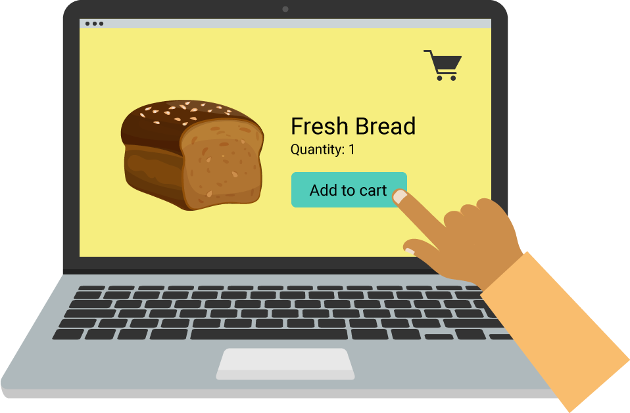
How a Session is Created
Before the session:
Bob visits a shopping site and clicks a button to add one loaf of bread to his shopping cart.
Bob’s browser
Image source: shutterstock_718101448, shutterstock_224259943, shutterstock_1593701509
‹#›

Slide 56
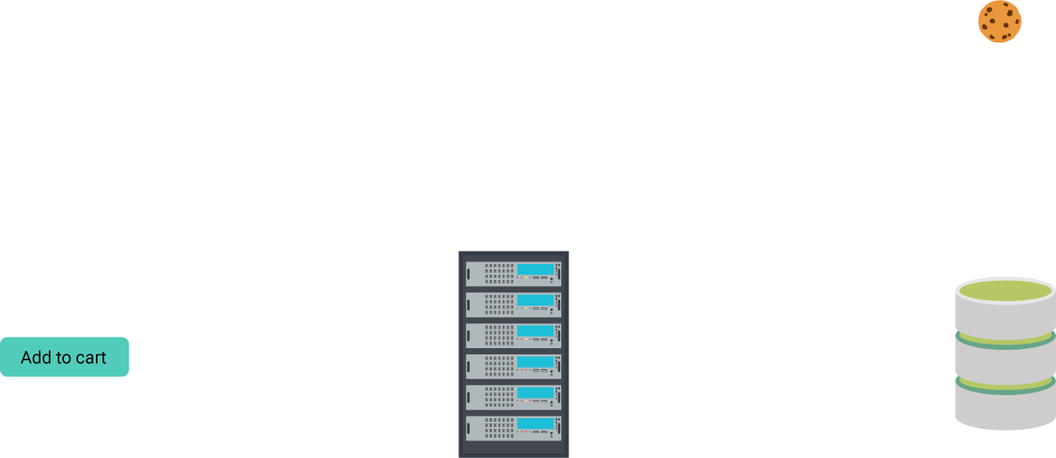
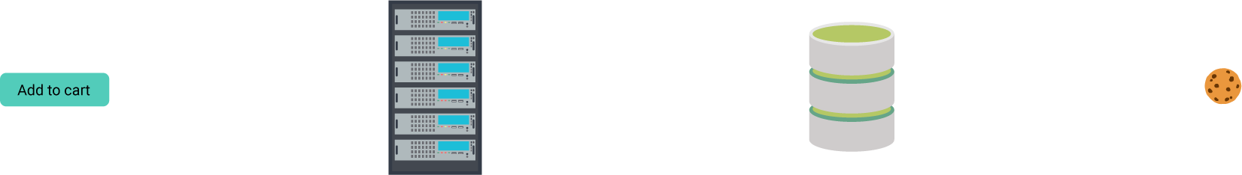
How a Session is Created
Create Cookie
The HTTP server processes the POST request, and creates a cookie for Bob.
Request
The button sends a POST request to the HTTP server with Bob’s one cart item.
Button
Initiate Session
In the database
HTTP
server
POST /products/ HTTP/1.1
User-Agent: Mozilla/4.0
Host:example.com
Content-Type: text/html
Connection: Keep-Alive
Accept-Encoding: gzip, deflate
addItem=Bread&count=1
Database
Create Session
The site’s database stores the session info with Bob’s shopping list, and links it to the cookie.
Bob’s
session

Slide 57
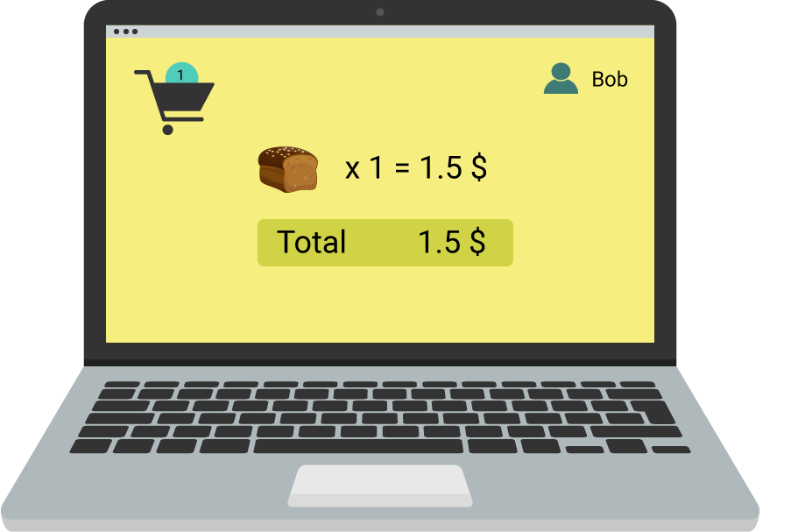
How a Session is Created
The HTTP server sends a response back to Bob’s browser with:
A cookie, sent through the response header.
Bob’s session information, embedded in the response body.
HTTP/1.1 200 OK
Date: Fri, 13 Mar 2020 12:28:53 GMT
Server: Apache/2.2.14 (Win 32)
Content-Length: 88
Content-Type: text/html
Set-Cookie: cart=Bob
<html><head>Bob’s cart<head>...
Bob’s browser

Slide 58
How a Session is Created
Resuming the response:
GET /stuff/ HTTP/ 1.1
User-Agent: Mozilla/4.0
Host: example.com
Cookie: cart=Bob
Content-Type: text/html
Connection: Keep-Alive
Accept-Encoding: gzip. deflate
When Bob revisits the webpage, his browser sends the cookie back through the request header.
HTTP server
‹#›

Slide 59

Implementations of cookies vary between sites. Some are more secure than others.
If Bob’s account was the fifth account to ever be created on a website, his cookie might look like: Set-Cookie: Session-ID=5
An attacker can change their cookie’s value so that when they make a request, they do so as Bob.
Modern session cookies contain uniquely hashed values specific to users, e.g. Set-Cookie: Session-ID=299367cd4c0e2c6d3ae6e09eda4e0590
While this keeps session ID cookies from being reverse engineered, an attacker can commit man-in-the-middle attacks by stealing cookies.
‹#›
Notes:
Image source: shutterstock_702250606

Slide 60
Session with Cookie-Editor
We’ll use a Chrome extension called Cookie-Editor to take a closer look at sessions and cookies in our browser.
We’ll complete the following steps:
1
2
3
4
Install the Chrome extension Cookie-Editor.
Create a user on a webpage and export the cookie to the clipboard with Cookie-Editor.
Create a new user, overwriting the old user's cookie, and their session.
Import the first user's session to show how a simple tool can be used to swap sessions.
‹#›

Slide 61
Cookie-Editor
‹#›

Slide 62
Activity: Swapping Sessions
In this activity, you’ll use Cookie-Editor to
examine how an attacker can hijack a session.
25 Minutes
‹#›

Slide 63
‹#›

